Slide 1
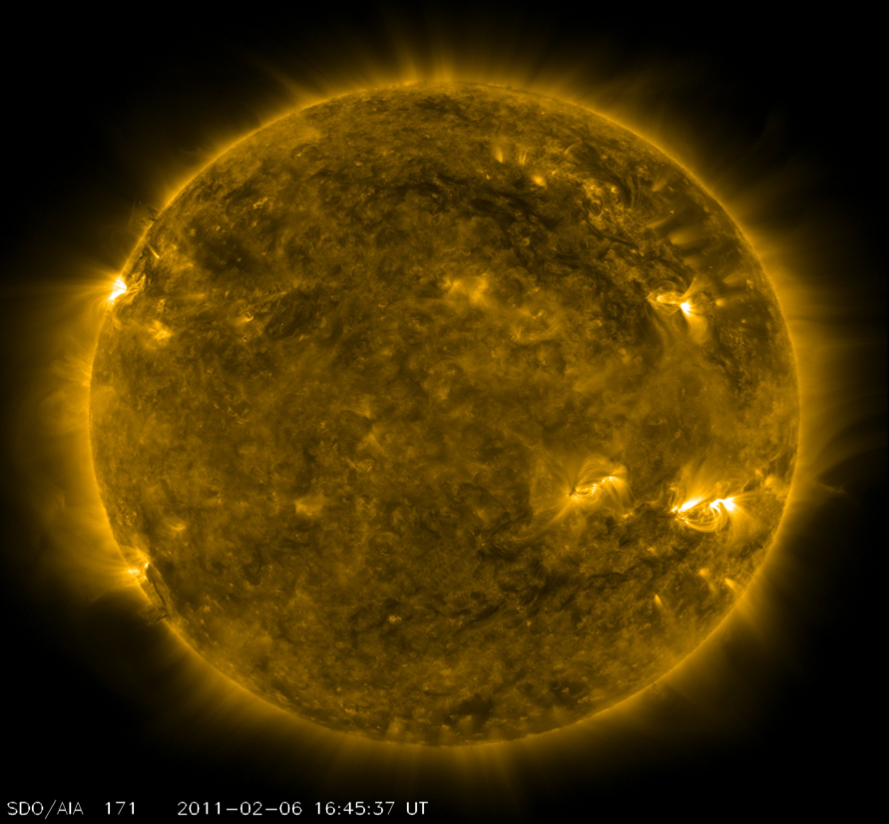
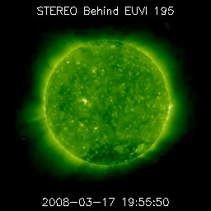
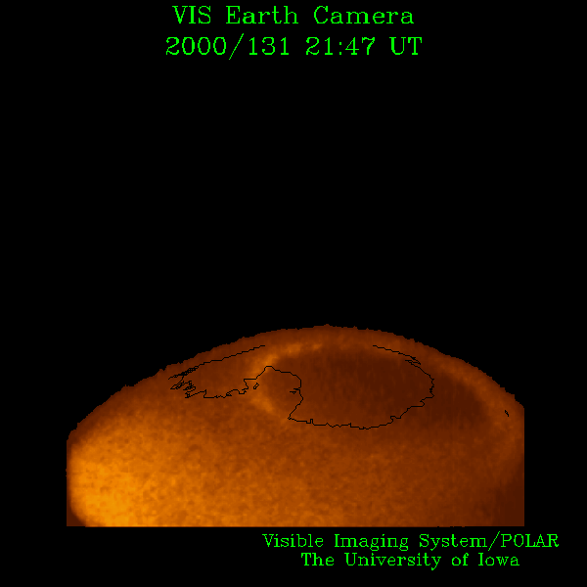
Space Weather Forecasting in a Shifting Environment
Michael Hesse
Chief, Space Weather Laboratory
NASA GSFC
michael.hesse@nasa.gov

Slide 2
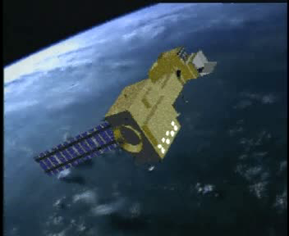
Elements of Space Weather Forecasting
Knowledge (Research)
Data/information
Models
Dissemination
NASA plays key role in all aspects

Slide 3
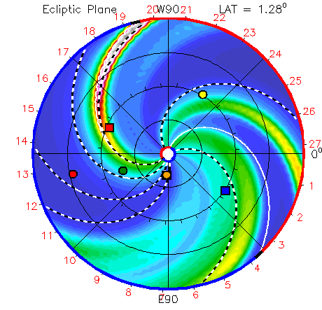
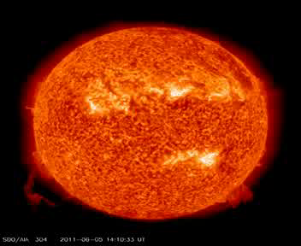
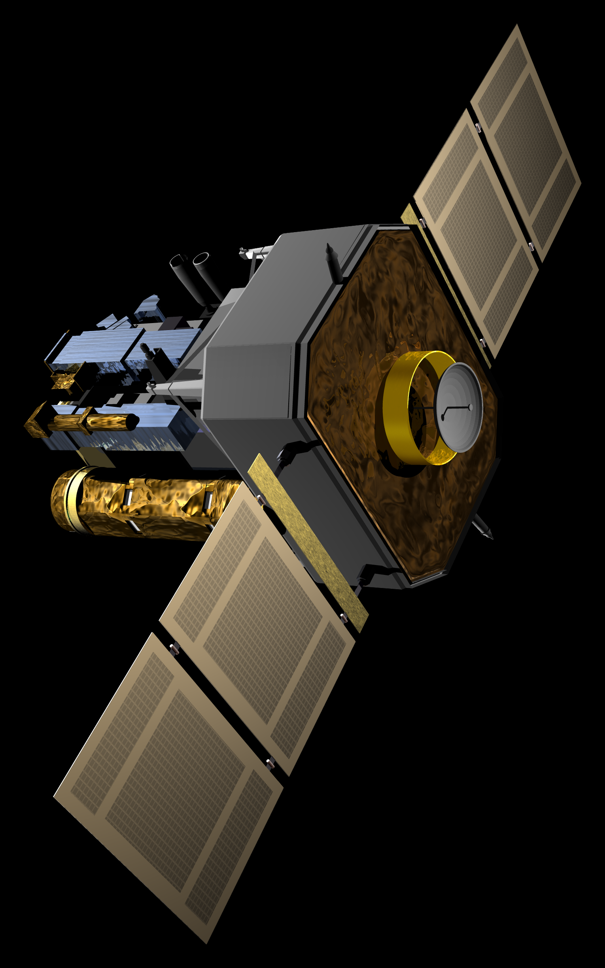
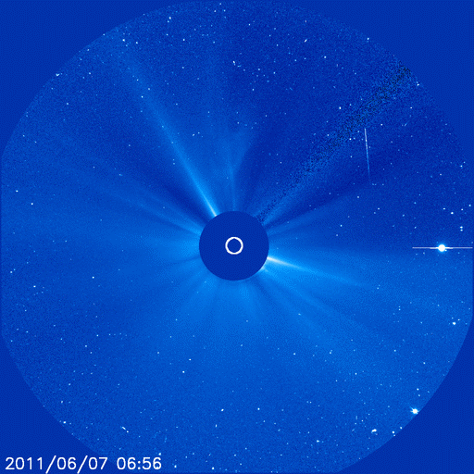
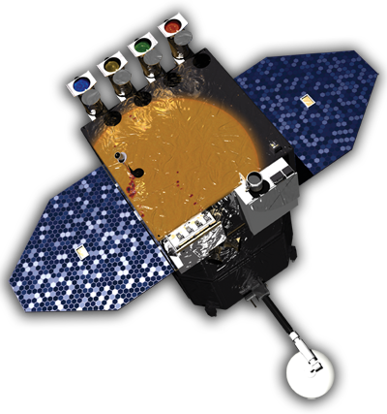
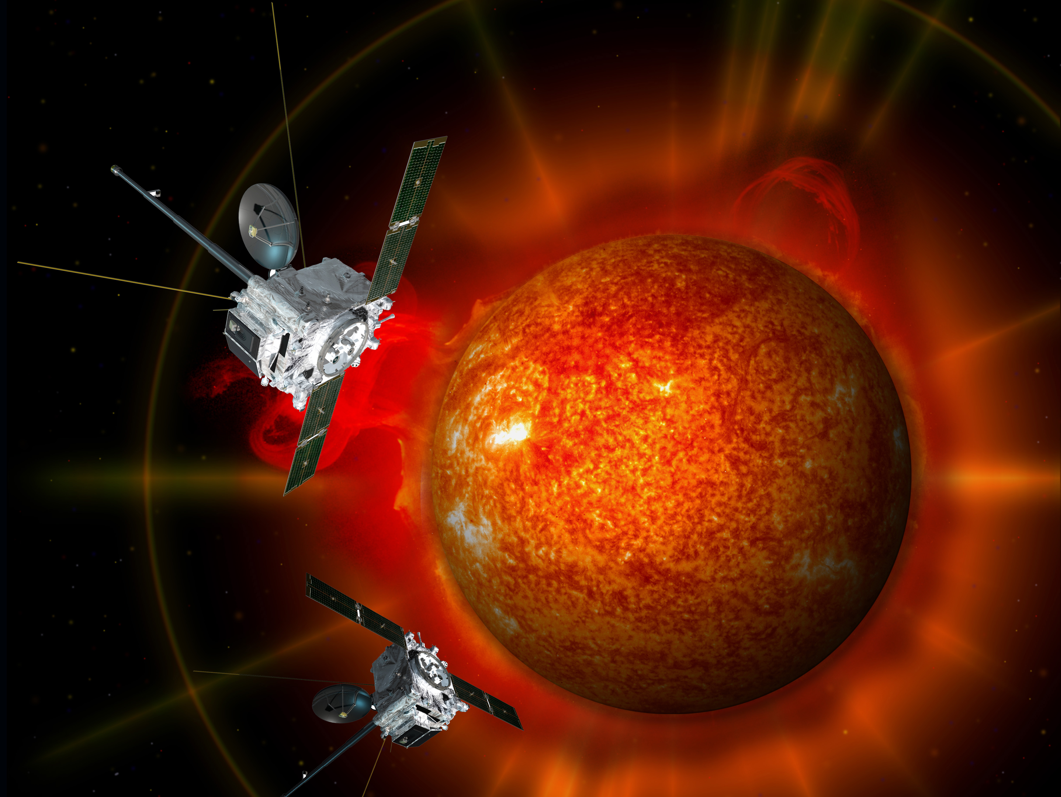
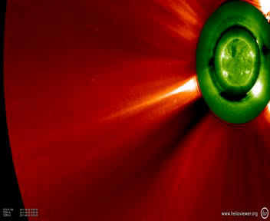
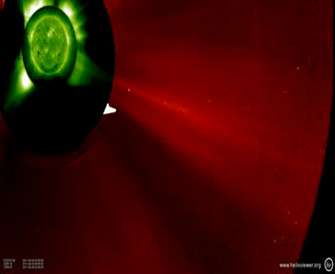
Observing the Sun: NASA’s Missions
STEREO A
SDO, SOHO
SOHO
SDO
A
STEREO B
STEREO A and B
B

Slide 4
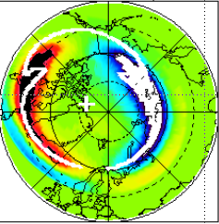
Modeling
NASA, with partner agencies: NSF, AFOSR, and ONR, sponsors the development of space research and environment models
These models run at GSFC’s Space Weather Laboratory in support of
Research and education
Model testing and validation, e.g., for NOAA/SWPC
SWx forecasting for NASA
Other national needs, including strong partnering with USAF Weather Agency
Space Weather Laboratory
http://swl.gsfc.nasa.gov
Supported by NASA and NSF

Slide 5
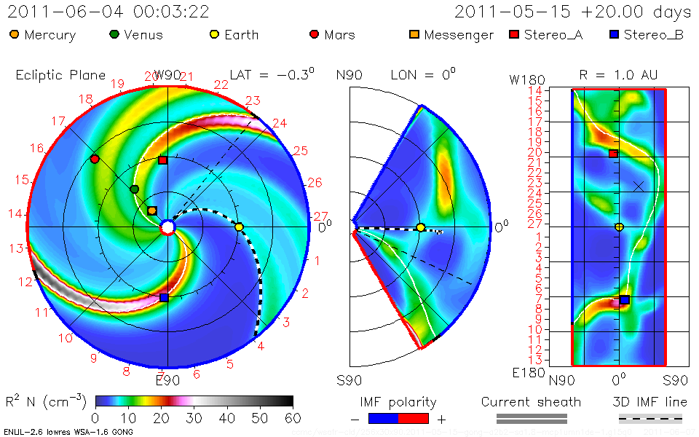
June 7, 2011 CME Forecast (1-3 days)

Slide 6
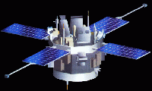
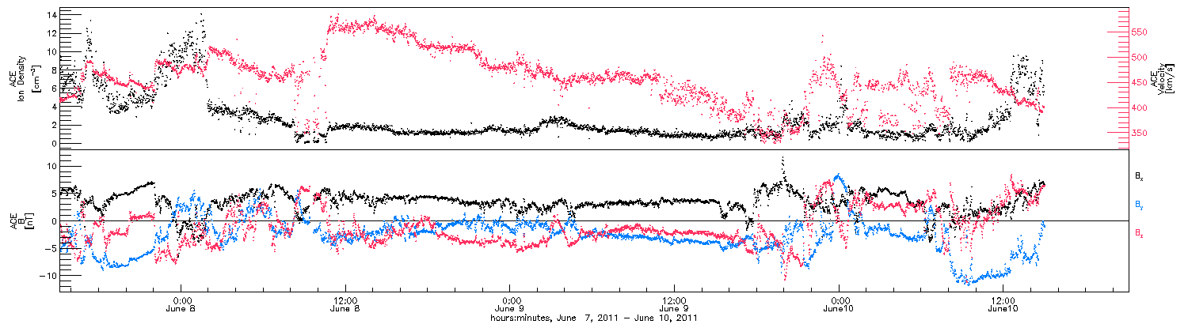
Short Term (~30mins) Warnings:
NASA’s ACE
CME flank arrival at Earth

Slide 7
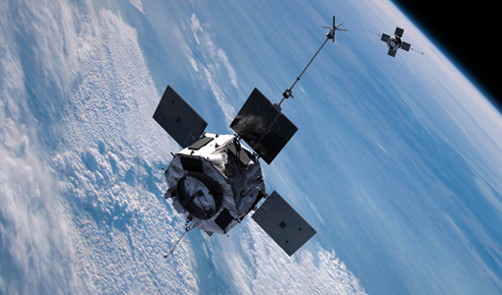
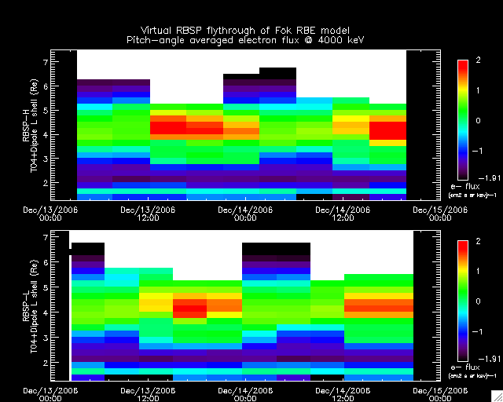
Future Missions: RBSP
Radiation Belt Storm Probes launch date: September, 2012
2 S/C, 5.8R_{E} apogee, 600km perigee, 10 degree inclination
2 year nominal mission lifetime
The RBSP Space Weather (SW) broadcast will be a transmission like those on ACE and STEREO.
Ground processing for SWx products will be provided by receiving organization(s).
Fundamental inputs into radiation belt models

Slide 8
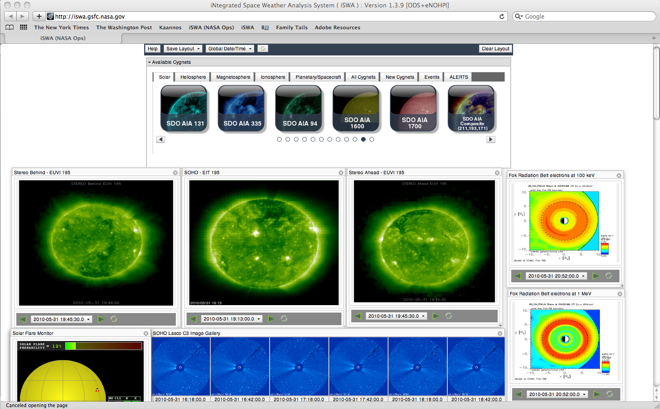
Innovative dissemination
One-stop shop for state-of-the-art information
> 250 SWx Tools
Flexible to adapt
to changing model
(and data) environment
User-configurable web-based system for analyzing space weather. Includes the most comprehensive list of SW data products and modeling results
iswa.ccmc.gsfc.nasa.gov
Available world-wide

Slide 9
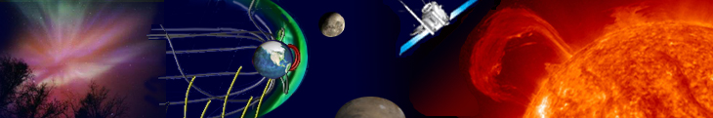
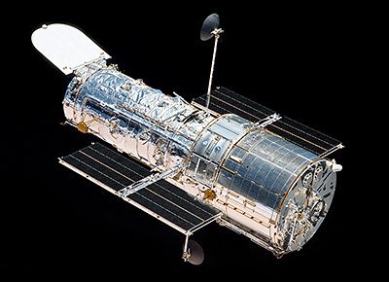


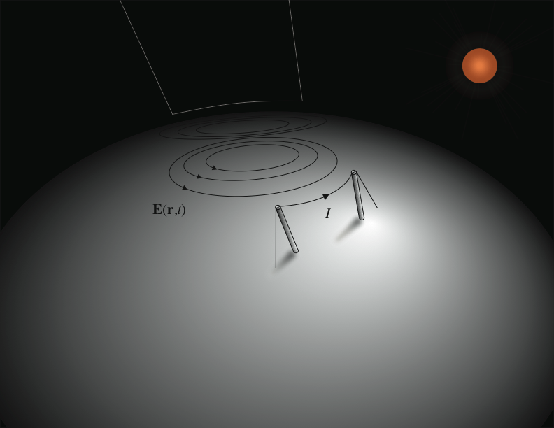
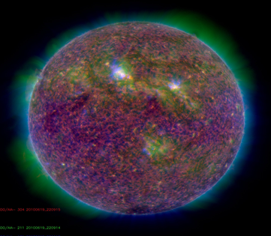

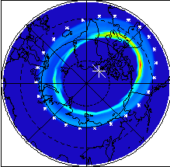
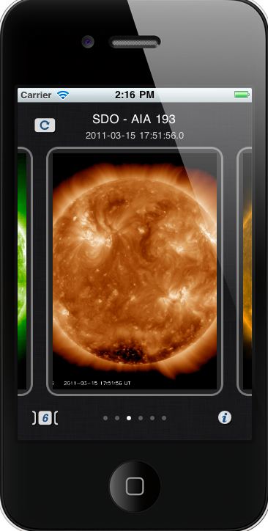
Space Weather Laboratory
World-leading modeling
Protecting NASA’s missions
Solar Shield
NASA, other, data streams
Space Weather Service
Protecting the power grid
AFWA
JSC/SRAG
Partnering
Space Weather for the public
Notes:
Our nation is increasingly dependent on space assets and our infrastructure is increasingly susceptible to space weather dangers. GSFC has combined forefront scientific knowledge, modeling skills, and access to space weather information to devise an innovative way to analyze and predict space weather hazards. The CCMC runs the world largest complement of advanced space science and space weather models in real time. The information obtained from these models is combined in a flexible, innovative, way, with data from space weather relevant missions (most of which are from NASA and available at GSFC). This information is analyzed in the Space Weather Laboratory by means of a world-leading display, analysis, and dissemination system (i.e., iSWA). SWL then disseminates information to NASA’s robotic missions, and to the JSC Space Radiation Analysis Group (SRAG) for human missions. Also developed at GSFC is the Solar Shield project, which uses advanced models to predict hazardous geomagnetically induced currents on the North American Power grid. Warnings are generated as needed and disseminated to our partner, the Electrical Power Research Institute for distribution to power grid operators. Space weather information is also made to other customers and to the general public via iSWA, as well as our iPhone app. In the words of Sam Williamson, the Federal Coordinator for Meteorology, the GSFC capability has leapfrogged that of NOAA’s Space Weather Prediction Center. SWL partners with a number of organizations world-wide, with a particularly close working relation with the USAF Weather Agency in Omaha, NE.

Slide 10
Solar Shield: Protecting the Power Grid
Geomagnetically induced current (GIC)
Notes:
- GIC flow also in pipelines but the major interest is in GIC impacts on power grids.

Slide 11
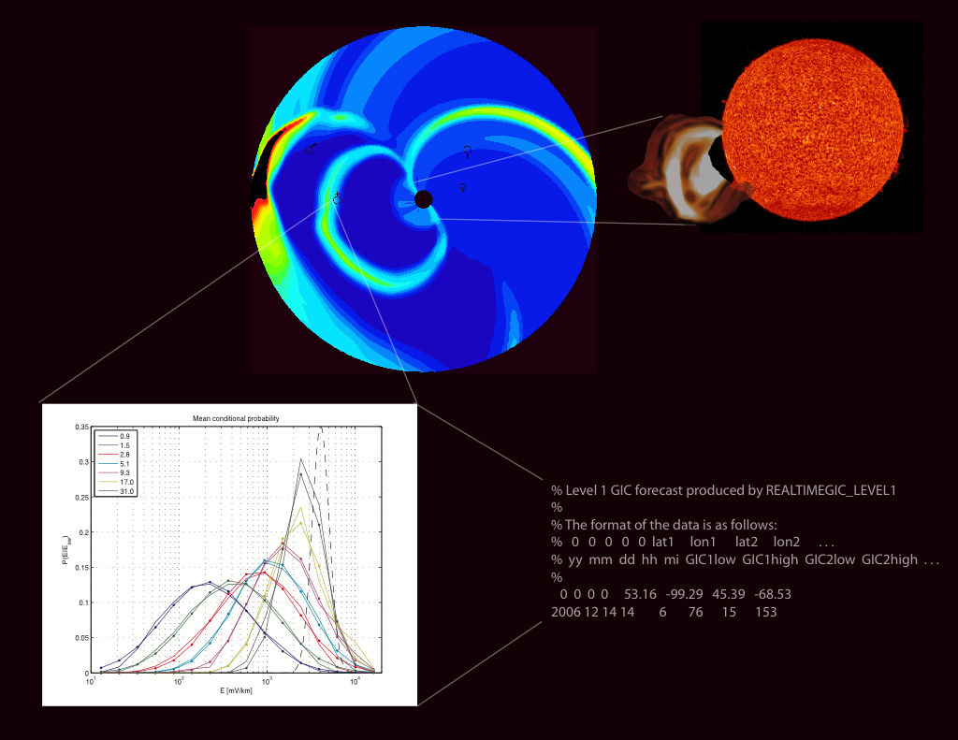
Level 1 forecasts
Notes:
Disturbances propagate from the surface of the Sun to the Earth in about 1-2 days.

Slide 12
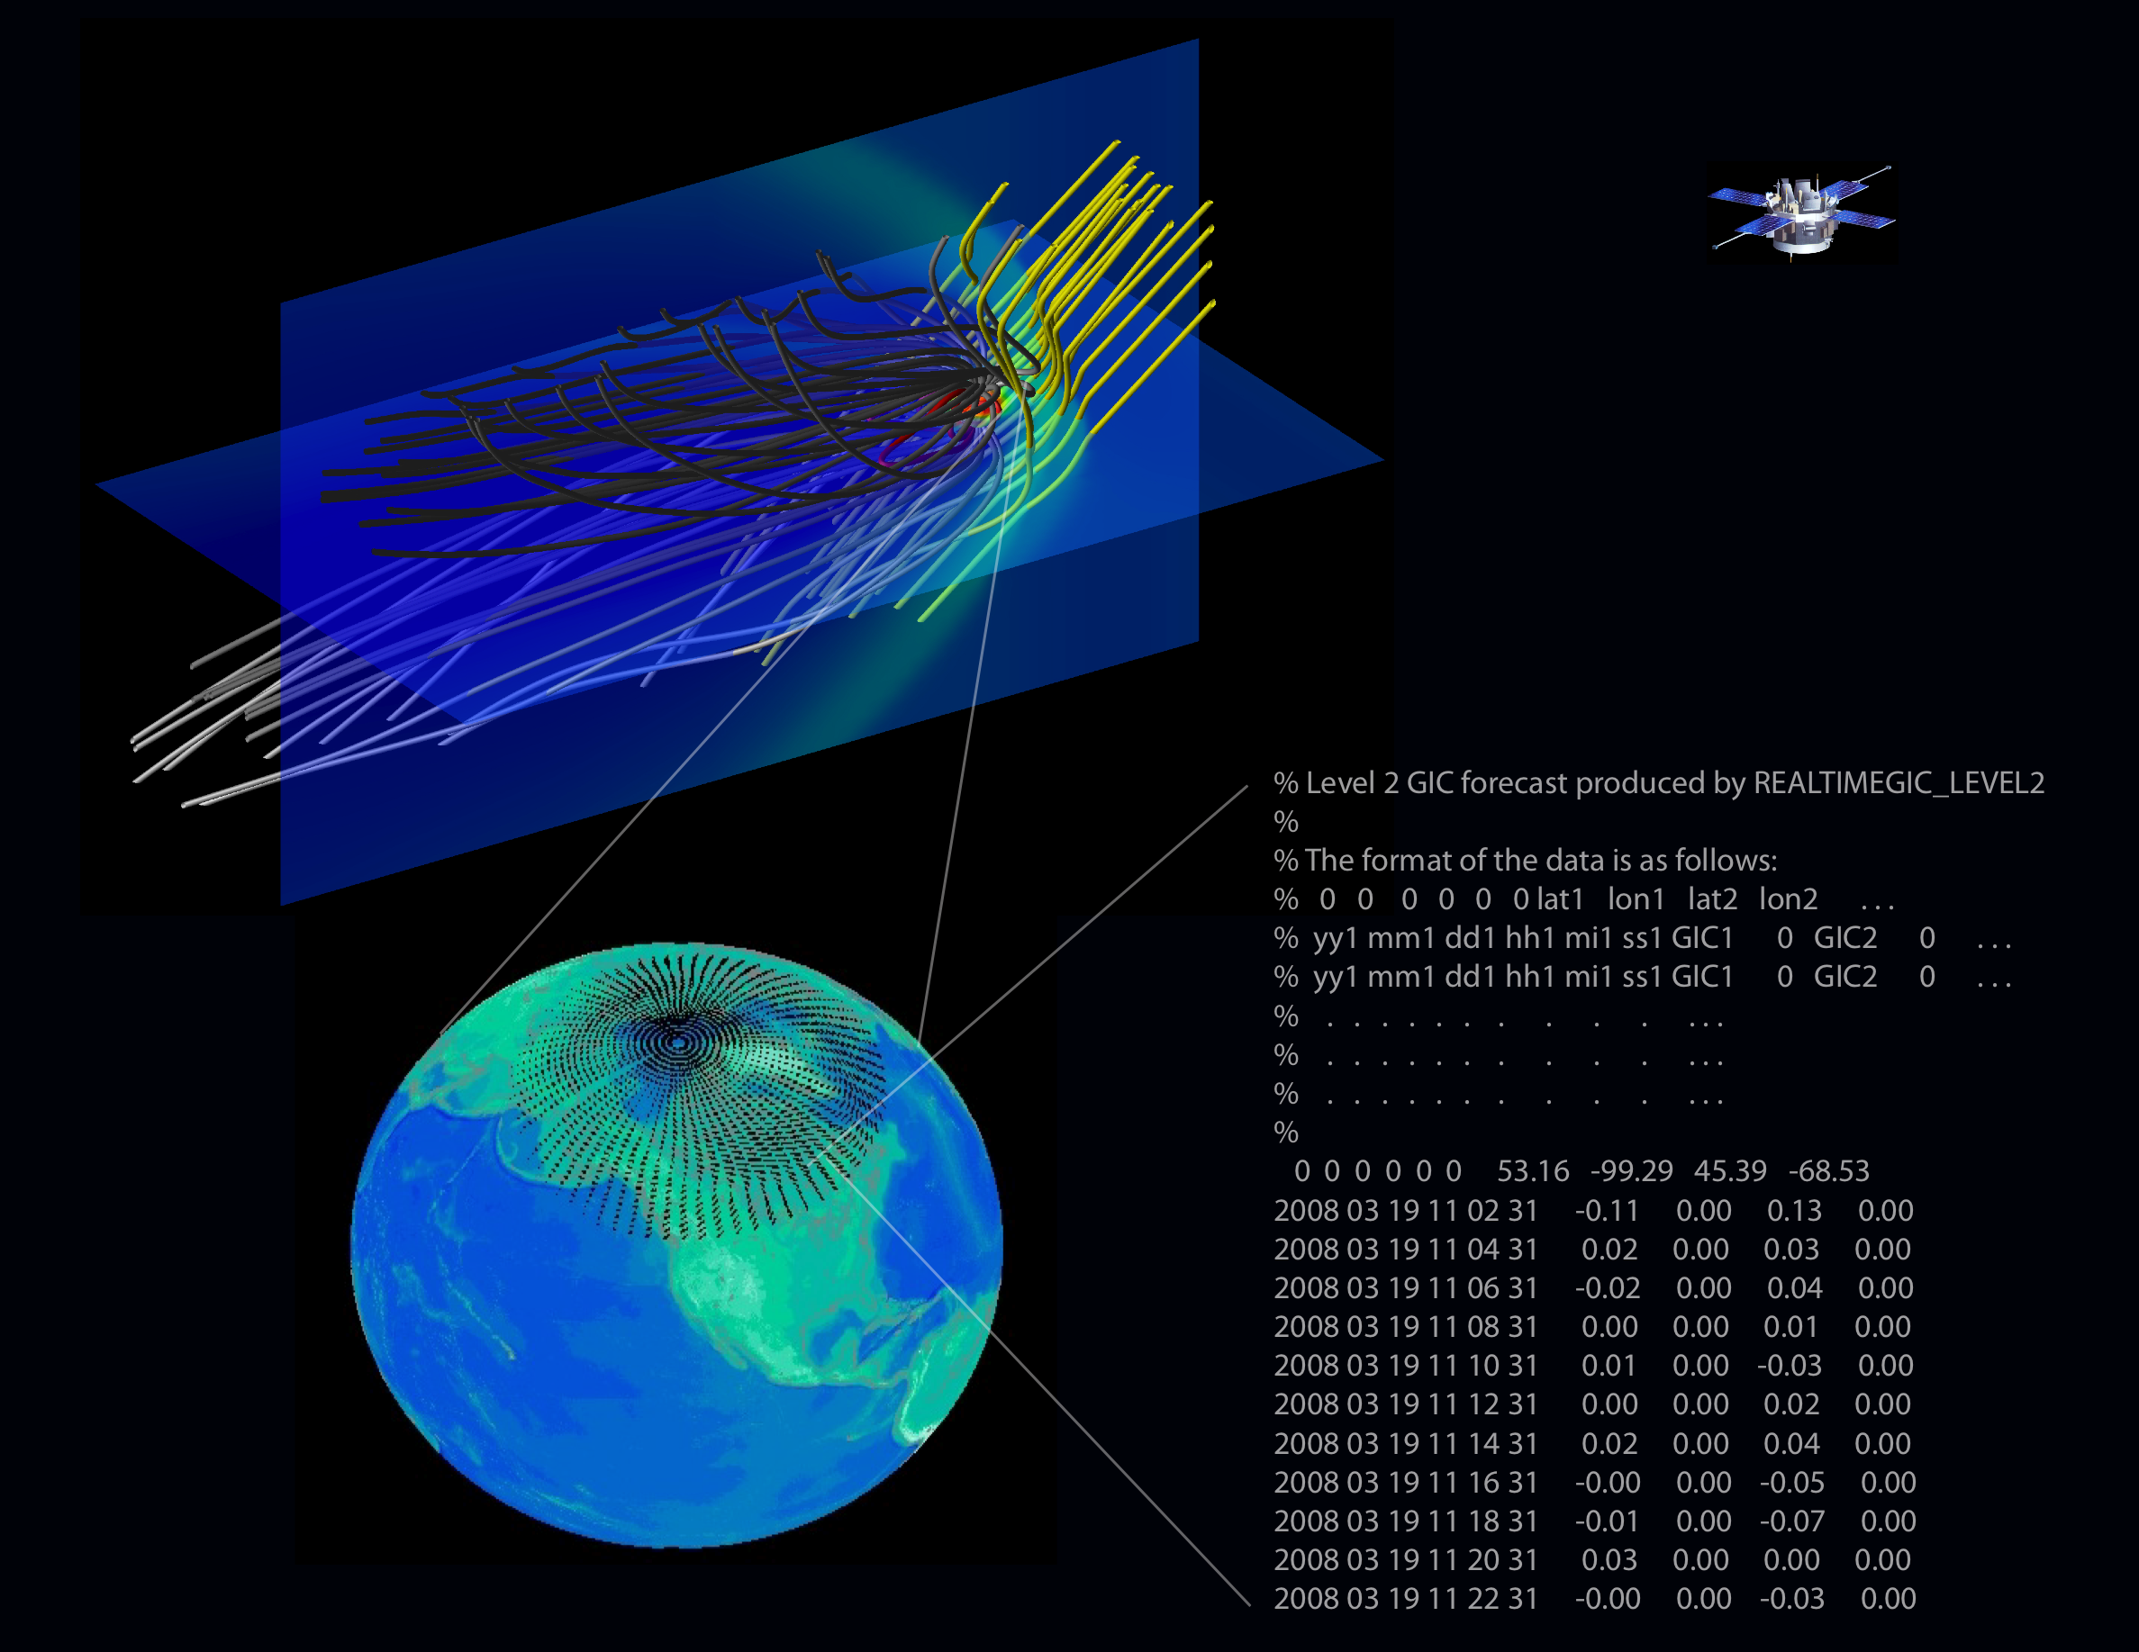
Supported by NASA, DHS
Collaborations with EPRI, DOE
Notes:
Solar wind propagates from L1 (1.5 million km upstream) to Earth in about 30-60 min.

Slide 13
Conclusions
NASA programs can, do, and will provide substantial and critical space weather information, even though they are presently focused primarily on science
GSFC has developed a world-leading information collection and public dissemination system, which supports NASA missions and other interests, such as the electrical power grid
Partnering, e.g., with AFWA, NSF, DHS, EPRI, Europe, Korea, Russia, commercial sector… is very important
Space weather benefits substantially by exploiting the proximity to scientific research.
There is tremendous additional potential to address national space weather needs in innovative, collaborative, and cost-effective ways.

